Slide 1
Statistics
The normal distribution
Twitter: @Owen134866
www.mathsfreeresourcelibrary.com

Slide 2
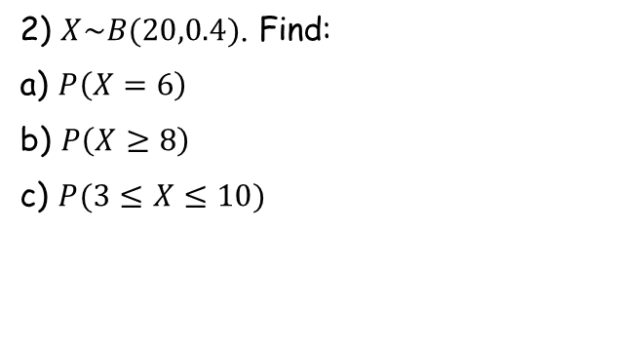
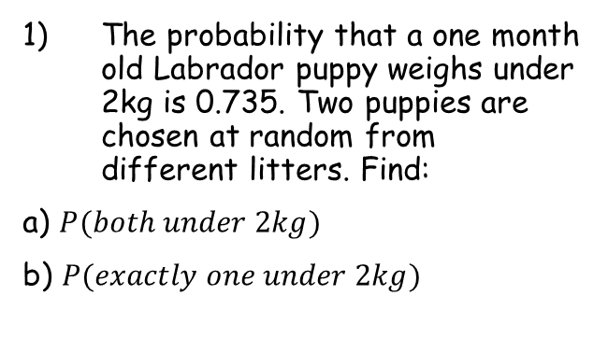
Prior knowledge check
The probability that a one month old Labrador puppy weighs under 2kg is 0.735. Two puppies are chosen at random from different litters. Find:
a) $P(both under 2kg)$
b) $P(exactly one under 2kg)$
3) The probability that a plate made using a particular production process is faulty is given as 0.16. A sample of 20 plates is taken. Find:
The probability that exactly two plates are faulty
The probability that no more than three plates are faulty
0.540
0.211
0.390
0.599
2) $X\sim B(20,0.4)$. Find:
a) $P\left(X=6\right)$
b) $P\left(X≥8\right)$
c) $P(3≤X≤10)$
0.124
0.584
0.869

Slide 3
Teachings for
Exercise 3A

Slide 4
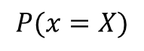
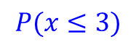
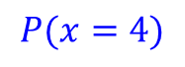
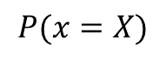

The normal distribution
Let $X=number of heads when 8 coins are thrown$
You need to understand the shape and basic ideas behind the normal distribution
In year 12 you will have encountered discrete random variables
The key numerical point was that these can only take certain values, determined by the context
$$P(x=X)$$
0
1
2
3
4
5
6
7
8
So although we haven not included a y-axis, the idea is that $X$ can only take certain values, and each will be assigned a probability (the height of its bar)
$$P(x≤3)$$
$$P(x=X)$$
$$P(x=4)$$
The probability of getting 4 heads will be equal to the height of this bar
The probability of getting 3 heads or less will be equal to the sum of the heights of these bars
0
1
2
3
4
5
6
7
8
3A

Slide 5
The normal distribution
The distribution of heights as a Histogram
You need to understand the shape and basic ideas behind the normal distribution
The normal distribution focuses on continuous random variables
These can take any numerical value (eg Height), and are modelled using a curve instead
For a quantity such as height, the majority of people will be close to the average
As we move further away from the average height, there are fewer people (ie – there would be a lower probability of randomly selecting one at that height)
130
140
150
160
170
180
If we reduce the classwidths used…
130
140
150
160
170
180
The shape of the Histogram becomes smoother. If we continue indefinitely, we get what is known as the normal distribution curve…
3A

Slide 6
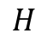
The normal distribution
175cm
You need to understand the shape and basic ideas behind the normal distribution
For example, if we decided to model the heights of adult males in a city…
Imagine that the mean height was 175cm, and the standard deviation was 12cm…
The curve will be split into equal halves either side of 175cm
The area under the curve is used to represent probabilities, with the total area underneath being equal to 1
Area = 0.5
Area = 0.5
$$H$$
140
150
160
170
180
190
200
210
So the probability of a randomly selected person being under 175cm tall is 0.5, based on this data
3A

Slide 7
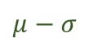
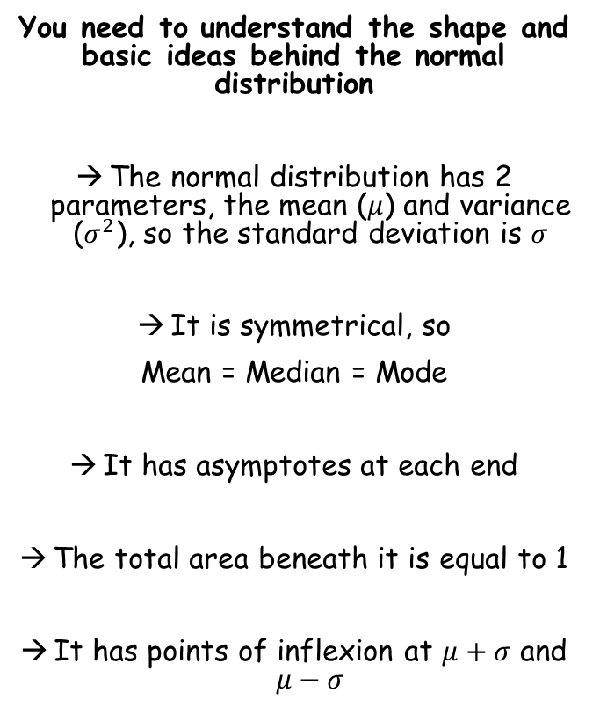
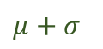
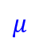
The normal distribution
You need to understand the shape and basic ideas behind the normal distribution
The normal distribution has 2 parameters, the mean ($μ$) and variance ($σ^{2}$), so the standard deviation is $σ$
It is symmetrical, so
Mean = Median = Mode
It has asymptotes at each end
The total area beneath it is equal to 1
It has points of inflexion at $μ+σ$ and $μ−σ$
$$μ−σ$$
$$μ$$
$$μ+σ$$
3A

Slide 8
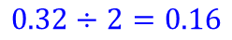
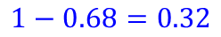
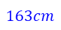
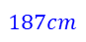
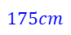
The normal distribution
$$1−0.68=0.32$$
You need to understand the shape and basic ideas behind the normal distribution
Approximately 68% of the data is within one standard deviation of the mean
Approximately 95% of the data is within 2 standard deviations of the mean
Almost all (99.7%) of the data is within 3 standard deviations of the mean
$$0.32÷2=0.16$$
So what would this area be?
So 16% of the males would have a height less than 163cm
Area = 0.68
Area = 0.16
$$163cm$$
$$175cm$$
$$187cm$$
$$H$$
For example, using the data from before, the height of adult males is being investigated, and we find the mean is 175cm and the standard deviation is 12cm
→ This means the area on the diagram above would be 0.68 (ie – the probability of a randomly chosen male falling into this region would be 68%)
3A

Slide 9
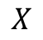
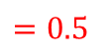
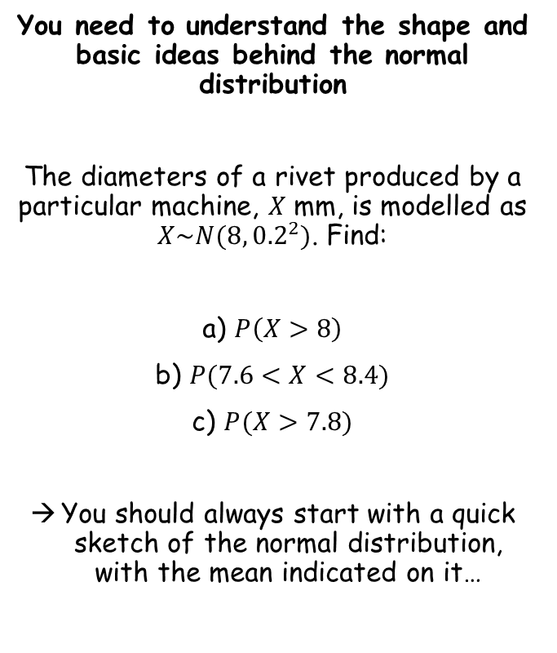
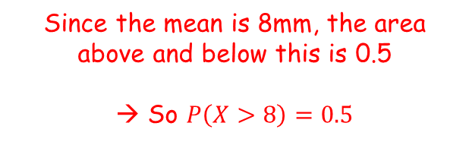
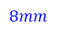
The normal distribution
You need to understand the shape and basic ideas behind the normal distribution
The diameters of a rivet produced by a particular machine, $X$ mm, is modelled as $X\sim N(8,{0.2}^{2})$. Find:
a) $P\left(X>8\right)$
b) $P(7.6<X<8.4)$
c) $P(X>7.8)$
You should always start with a quick sketch of the normal distribution, with the mean indicated on it…
Area = 0.5
Area = 0.5
(normally distributed with a mean of 8mm and a standard deviation of 0.2)
$$8mm$$
$$X$$
$$=0.5$$
Since the mean is 8mm, the area above and below this is 0.5
→ So $P\left(X>8\right)=0.5$
3A

Slide 10
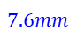
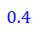
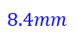
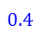
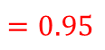
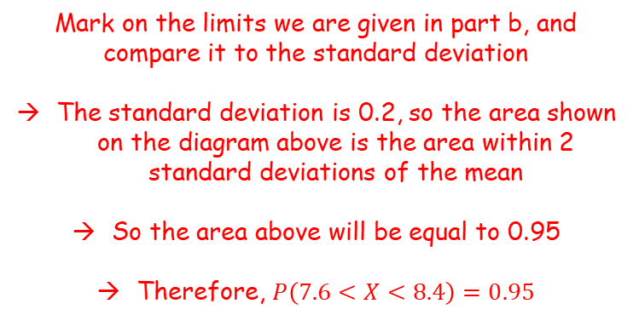
The normal distribution
You need to understand the shape and basic ideas behind the normal distribution
The diameters of a rivet produced by a particular machine, $X$ mm, is modelled as $X\sim N(8,{0.2}^{2})$. Find:
a) $P\left(X>8\right)$
b) $P(7.6<X<8.4)$
c) $P(X>7.8)$
You should always start with a quick sketch of the normal distribution, with the mean indicated on it…
Area = 0.95
$$7.6mm$$
$$8mm$$
$$8.4mm$$
$$X$$
$$=0.5$$
$$0.4$$
$$0.4$$
$$=0.95$$
Mark on the limits we are given in part b, and compare it to the standard deviation
The standard deviation is 0.2, so the area shown on the diagram above is the area within 2 standard deviations of the mean
So the area above will be equal to 0.95
Therefore, $P\left(7.6<X<8.4\right)=0.95$
3A

Slide 11
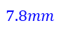
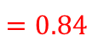
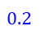
The normal distribution
You need to understand the shape and basic ideas behind the normal distribution
The diameters of a rivet produced by a particular machine, $X$ mm, is modelled as $X\sim N(8,{0.2}^{2})$. Find:
a) $P\left(X>8\right)$
b) $P(7.6<X<8.4)$
c) $P(X>7.8)$
You should always start with a quick sketch of the normal distribution, with the mean indicated on it…
Area = 0.34
Area = 0.5
$$7.8mm$$
$$8mm$$
$$X$$
$$=0.5$$
$$0.2$$
$$=0.95$$
Mark on the value we are given in part c)
The standard deviation is 0.2, so the area shown on the diagram above is the area within 1 standard deviation of the mean
So the area between 7.8mm and 8mm will be equal to 0.68 ÷ 2 (0.34)
The area above 7.8mm will therefore be equal to 0.34 + 0.5 (0.84)
$$=0.84$$
3A

Slide 12

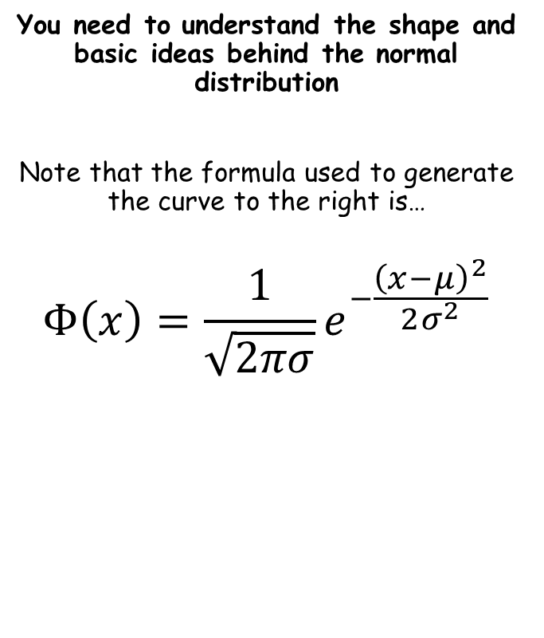
The normal distribution
You need to understand the shape and basic ideas behind the normal distribution
Note that the formula used to generate the curve to the right is…
$$Φ\left(x\right)=\frac{1}{\sqrt{2πσ}}e^{−\frac{{\left(x−μ\right)}^{2}}{2σ^{2}}}$$
This means the area under the graph, up to point $x$
3A

Slide 13
Teachings for
Exercise 3B

Slide 14
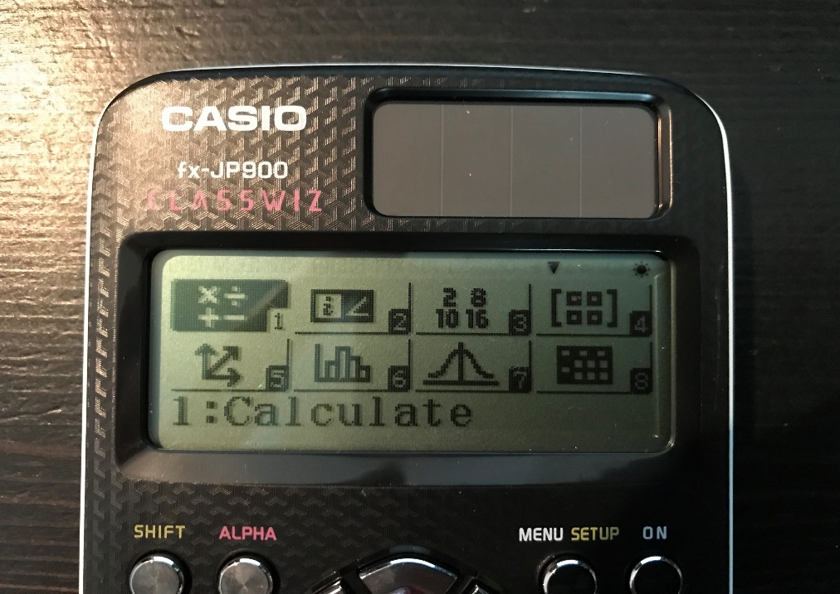
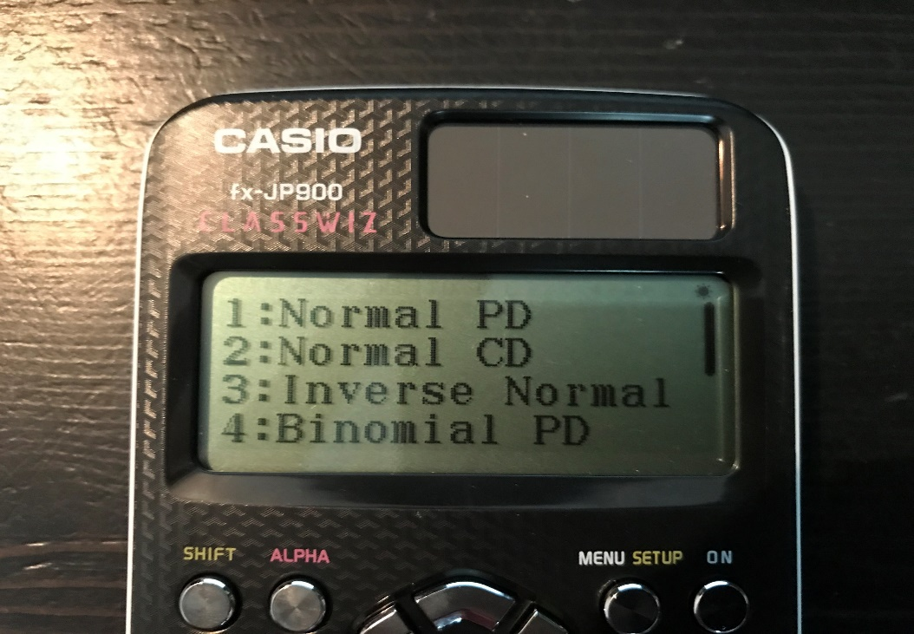
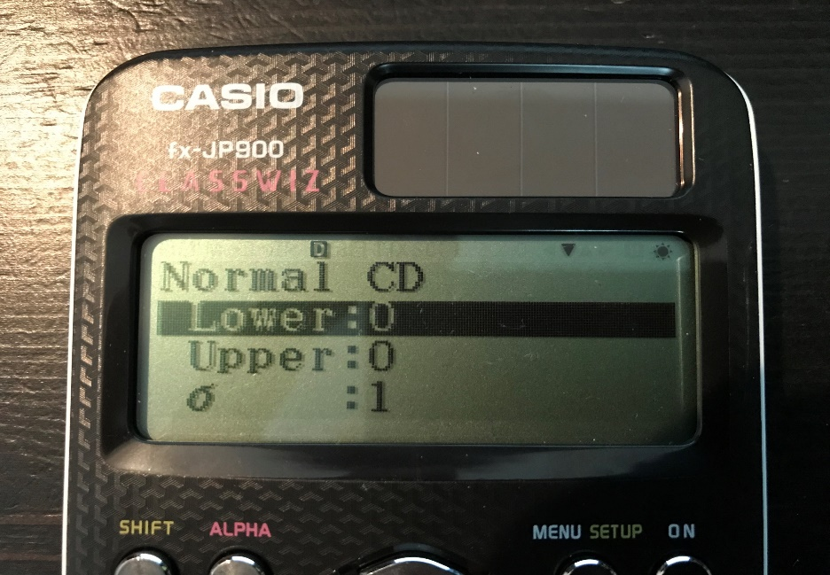
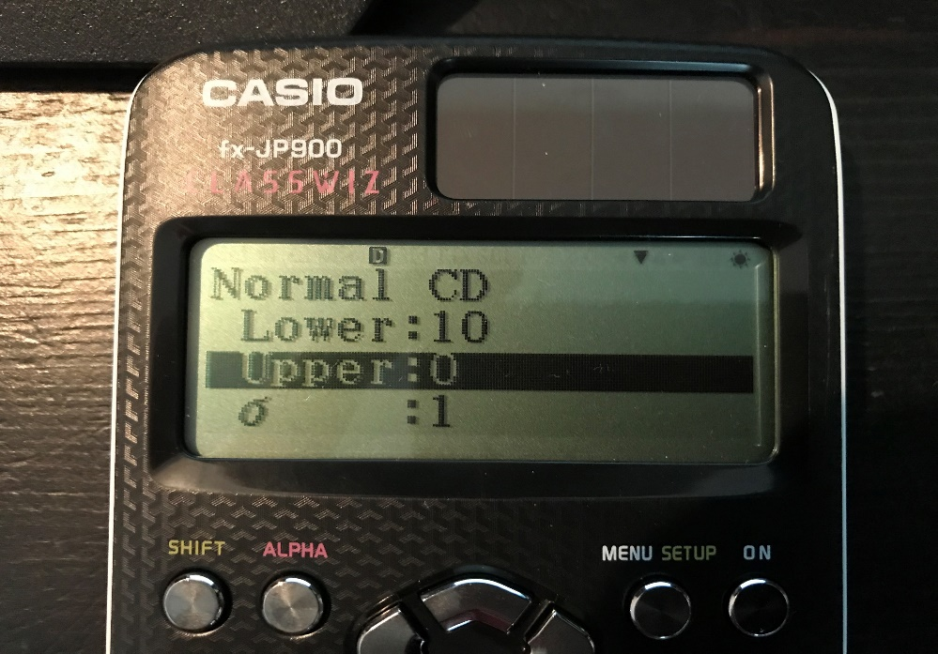
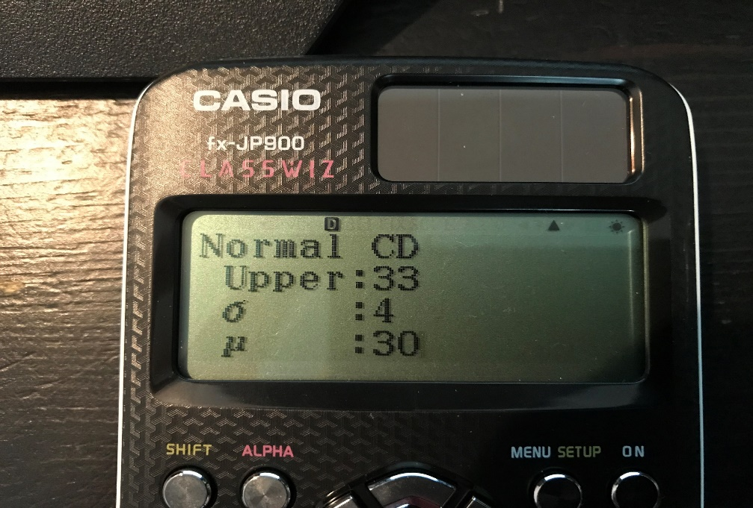
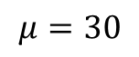
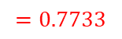
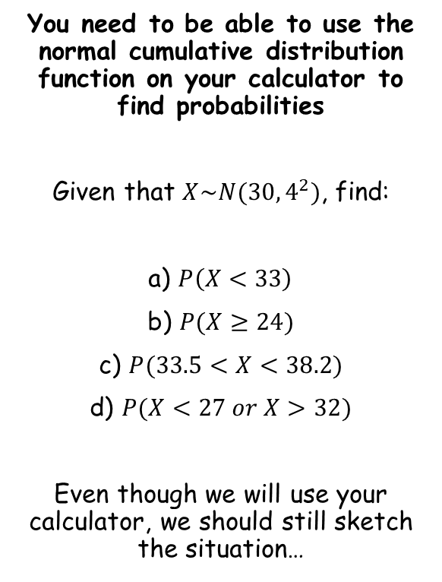
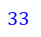
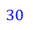
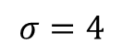
The normal distribution
→ Now, on your calculator, press menu
$$μ=30$$
You need to be able to use the normal cumulative distribution function on your calculator to find probabilities
Given that $X\sim N(30,4^{2})$, find:
a) $P\left(X<33\right)$
b) $P(X≥24)$
c) $P(33.5<X<38.2)$
d) $P(X<27 or X>32)$
Even though we will use your calculator, we should still sketch the situation…
$$σ=4$$
→ Now press 7 for distributions
$$30$$
$$33$$
$$=0.7733$$
→ Now press 2 for the normal cumulative distribution
→ Now input the lower limit. If there is no lower limit, choose a value at least 5 standard deviations below the mean (so in this case any value less than or equal to 10 would be fine)
→ Now input the upper limit (in this case 33), the standard deviation and the mean
→ Press equals and the calculator will tell you the area!
3B

Slide 15
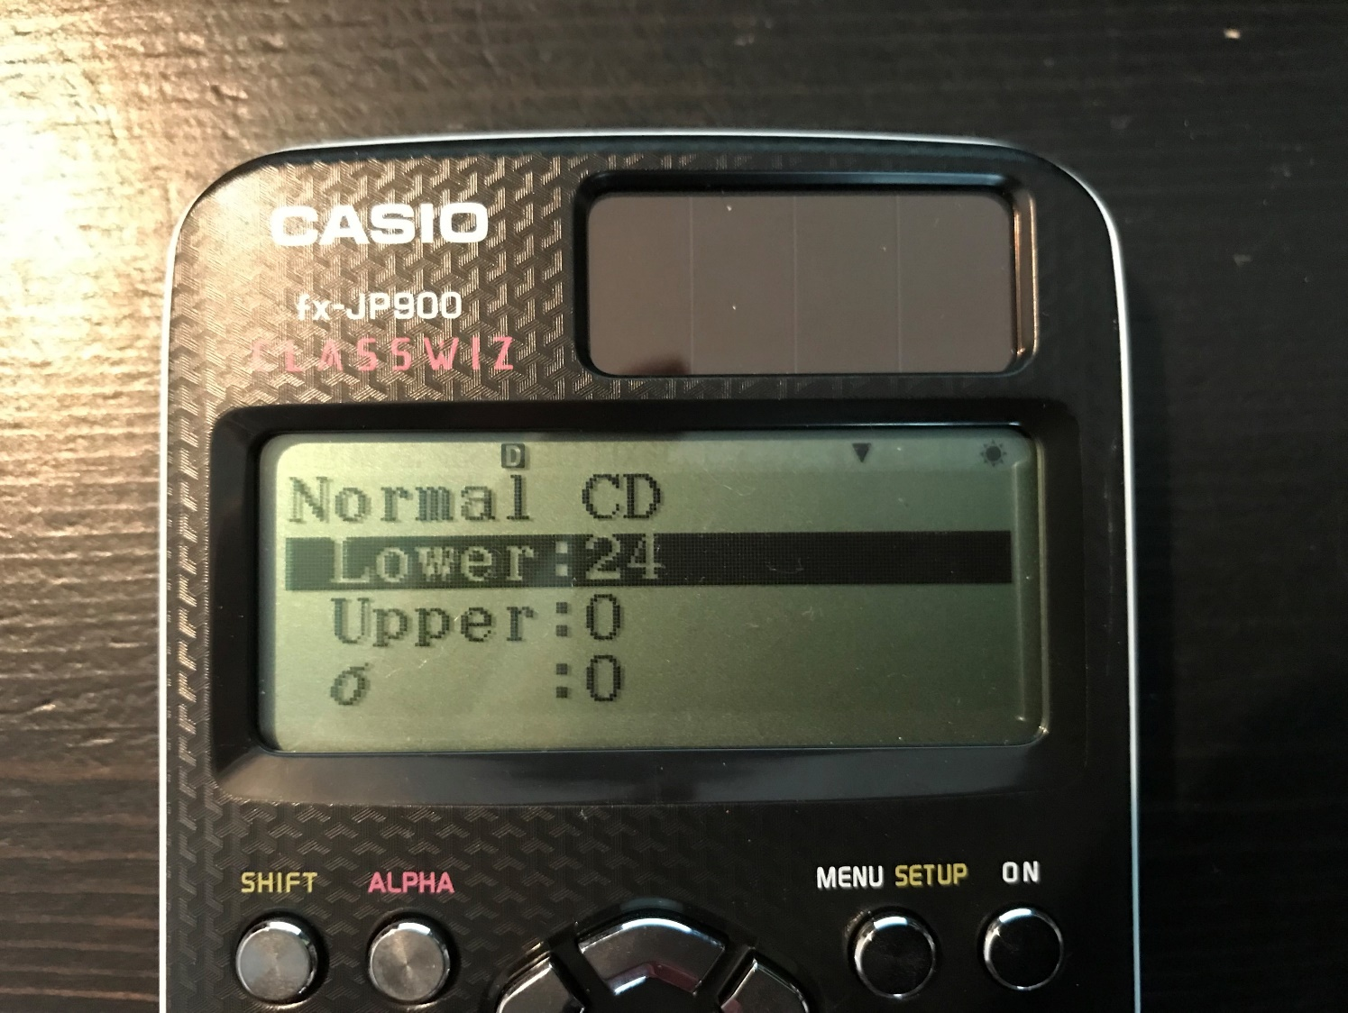
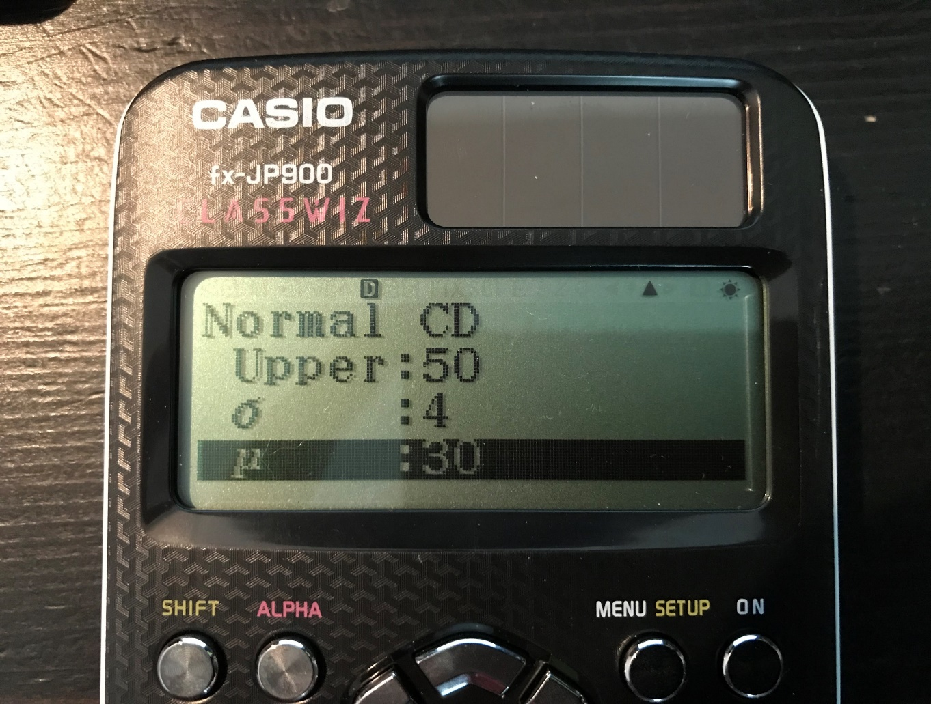
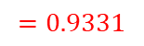
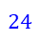
The normal distribution
$$μ=30$$
You need to be able to use the normal cumulative distribution function on your calculator to find probabilities
Given that $X\sim N(30,4^{2})$, find:
a) $P\left(X<33\right)$
b) $P(X≥24)$
c) $P(33.5<X<38.2)$
d) $P(X<27 or X>32)$
Even though we will use your calculator, we should still sketch the situation…
$$σ=4$$
$$24$$
$$30$$
$$=0.7733$$
→ Input the lower limit (in this case 24 – it does not matter whether the inequality also includes 24 or not)
$$=0.9331$$
→ Now input the upper limit (in this case there is none, so any value above 50), the standard deviation and the mean
→ Press equals and the calculator will tell you the area
3B

Slide 16
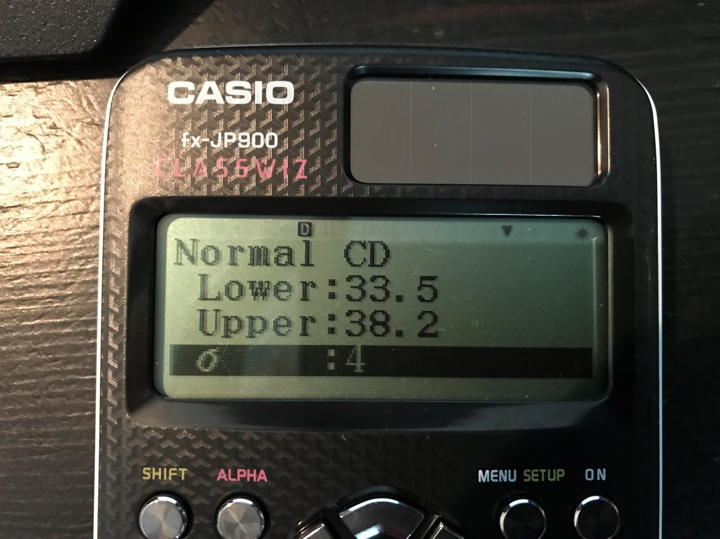
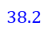
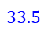
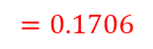
The normal distribution
$$μ=30$$
You need to be able to use the normal cumulative distribution function on your calculator to find probabilities
Given that $X\sim N(30,4^{2})$, find:
a) $P\left(X<33\right)$
b) $P(X≥24)$
c) $P(33.5<X<38.2)$
d) $P(X<27 or X>32)$
Even though we will use your calculator, we should still sketch the situation…
$$σ=4$$
$$30$$
$$33.5$$
$$38.2$$
$$=0.7733$$
→ Now input both limits, the standard deviation and the mean (it does not matter whether the inequality includes the value or not)
$$=0.9331$$
$$=0.1706$$
→ Press equals and the calculator will tell you the area
3B

Slide 17





The normal distribution
$$μ=30$$
You need to be able to use the normal cumulative distribution function on your calculator to find probabilities
Given that $X\sim N(30,4^{2})$, find:
a) $P\left(X<33\right)$
b) $P(X≥24)$
c) $P(33.5<X<38.2)$
d) $P(X<27 or X>32)$
Even though we will use your calculator, we should still sketch the situation…
$$σ=4$$
In this case, we can find the area between 27 and 32, and then subtract it from 1…
$$27$$
$$30$$
$$32$$
$$=0.7733$$
$$=0.9331$$
→ Now input the limits, mean and standard deviation
$$=0.1706$$
$$=0.5352$$
→ Press equals
$$=0.4648$$
→ In this case, remember that you need to subtract the answer from 1…
3B

Slide 18

The normal distribution
You need to be able to use the normal cumulative distribution function on your calculator to find probabilities
An IQ test is applied to a population of adults. The scores, X, on the test are found to be normally distributed with $X\sim N(100,{15}^{2})$. Adults scoring more than 140 on the test are classified as ‘genius’.
Find the probability that an adult chosen at random achieves a ‘genius’ classification
Twenty adults take the test. Find the probability that two or more are classified as ‘genius’
Use your calculator as before. The lower limit should be 140, the upper limit should be at least 175 (5 times the standard deviation above the mean).
The mean is 100 and the standard deviation is 15…
= 0.00383
3B

Slide 19

The normal distribution
For this part you will need to use what you learned in year 12 (the binomial distribution)
There are 20 adults in the sample, and the probability of a genius is 0.00383
Therefore, for this part, $X\sim B(20,0.00383)$
If we let $Y=number of geniuses$, we want:
$$P(Y≥2)$$
which equals $1−P(Y<2)$
which equals $1−P(Y≤1)$
→On your calculator, press 7, down, 1, 2, and input the number of successes we are considering (1), the number of trials (20), and the probability of success (0.00383)
→ The calculator will give you the answer 0.9973… Remember to subtract this from 1
→ So the answer is 0.00266
You need to be able to use the normal cumulative distribution function on your calculator to find probabilities
An IQ test is applied to a population of adults. The scores, X, on the test are found to be normally distributed with $X\sim N(100,{15}^{2})$. Adults scoring more than 140 on the test are classified as ‘genius’.
Find the probability that an adult chosen at random achieves a ‘genius’ classification
Twenty adults take the test. Find the probability that two or more are classified as ‘genius’
= 0.00383
3B

Slide 20
Teachings for
Exercise 3C

Slide 21











The normal distribution
→ Now, on your calculator, press menu
$$μ=20$$
You also need to be able to use the inverse function on you calculator, to find values that will give specific probabilities
Given that $X\sim N\left(20,3^{2}\right),$find, to two decimal places, the values of $a$ such that:
a) $P\left(X<a\right)=0.75$
b) $P\left(X>a\right)=0.4$
c) $P\left(16<X<a\right)=0.3$
Draw a sketch to get an idea of where the value should be
→ You can use the area to estimate the value we are looking for…
$$σ=3$$
→ Now press 7 for distributions
Area = 0.75
$$20$$
$$a$$
→ Now press 3 for the Inverse normal distribution
$$=22.02$$
→ Now input the probability we want, as well as the standard deviation and mean
→ Press equals and the calculator will tell you the value which has this area below it (as in, below the value, to the left of it)
3C

Slide 22




The normal distribution
$$μ=20$$
You also need to be able to use the inverse function on you calculator, to find values that will give specific probabilities
Given that $X\sim N\left(20,3^{2}\right),$find, to two decimal places, the values of $a$ such that:
a) $P\left(X<a\right)=0.75$
b) $P\left(X>a\right)=0.4$
c) $P\left(16<X<a\right)=0.3$
Draw a sketch to get an idea of where the value should be
→ If the area above a value is 0.4, that value must be above the mean
$$σ=3$$
Area = 0.4
$$a$$
$$20$$
$$=22.02$$
→ Be careful here! The calculator bases calculations on the area below the value given. So in this case, we need to put in the probability as 0.6.
$$=20.76$$
→ After putting the mean and standard deviation in as well, the calculator will tell you the value…
3C

Slide 23







The normal distribution
$$μ=20$$
You also need to be able to use the inverse function on you calculator, to find values that will give specific probabilities
Given that $X\sim N\left(20,3^{2}\right),$find, to two decimal places, the values of $a$ such that:
a) $P\left(X<a\right)=0.75$
b) $P\left(X>a\right)=0.4$
c) $P\left(16<X<a\right)=0.3$
Draw a sketch to get an idea of where the value should be
$$σ=3$$
Area = 0.3
Area = 0.0912
$$16$$
$$a$$
$$20$$
→ The total area ‘below’ value $a$ will be equal to 0.3 plus the area below 16. We can find the area below 16 using the function on your calculator we used in section 3B
$$=22.02$$
$$=20.76$$
$$=19.17$$
→ It is 0.0912…
→ So put in an area of 0.3912, as well as the mean and standard deviation, in order to find the value $a$
3C

Slide 24





The normal distribution
$$μ=20$$
You also need to be able to use the inverse function on you calculator, to find values that will give specific probabilities
Plates made using a particular manufacturing process have a diameter, $D cm$, which can be modelled using a normal distribution, $D\sim N(20,{1.5}^{2})$.
Given that 60% of plates are less than $x cm$, find the value of $x$.
Find the interquartile range of the plate diameters
$$σ=1.5$$
Area = 0.6
$$20$$
$$x$$
Use your calculator as before to find the value $x$.
The mean is 20, the standard deviation is 1.5, and the area/probability is 0.6
The answer is 20.38cm
$$=20.38cm$$
3C

Slide 25


The normal distribution
$$μ=20$$
You also need to be able to use the inverse function on you calculator, to find values that will give specific probabilities
Plates made using a particular manufacturing process have a diameter, $D cm$, which can be modelled using a normal distribution, $D\sim N(20,{1.5}^{2})$.
Given that 60% of plates are less than $x cm$, find the value of $x$.
Find the interquartile range of the plate diameters
Area = 0.25
$$σ=1.5$$
Area = 0.25
Area = 0.25
Area = 0.25
$$LQ$$
$$20$$
$$UQ$$
Firstly, remember that for normally distributed data, Mean = Median = Mode, so the value of 20 is also the Median
Secondly, remember that the quartiles and the median split the data into 4 equal parts, with the same quantity of data in each
Therefore, the area below the lower quartile (and all the other areas), will be 0.25
$$=20.38cm$$
3C

Slide 26



The normal distribution
$$μ=20$$
You also need to be able to use the inverse function on you calculator, to find values that will give specific probabilities
Plates made using a particular manufacturing process have a diameter, $D cm$, which can be modelled using a normal distribution, $D\sim N(20,{1.5}^{2})$.
Given that 60% of plates are less than $x cm$, find the value of $x$.
Find the interquartile range of the plate diameters
$$σ=1.5$$
Area = 0.25
$$LQ$$
$$20$$
$$UQ$$
$$18.988$$
$$21.011$$
$$1.011$$
$$1.011$$
So find the value that has an area of 0.25 less that it, using your calculator as before.
You should get 18.988…
Subtract this value from 20 to find the distance between the LQ and the Median
You should get 1.011
Then, add this to the Median to get the UQ
You should get 21.011
$$=20.38cm$$
3C

Slide 27

The normal distribution
$$μ=20$$
You also need to be able to use the inverse function on you calculator, to find values that will give specific probabilities
Plates made using a particular manufacturing process have a diameter, $D cm$, which can be modelled using a normal distribution, $D\sim N(20,{1.5}^{2})$.
Given that 60% of plates are less than $x cm$, find the value of $x$.
Find the interquartile range of the plate diameters
$$σ=1.5$$
Area = 0.25
$$18.988$$
$$20$$
$$21.011$$
So the interquartile range will be the difference between the two values we calculated
This is equal to 2.02, to 2dp
(note that we could also find the difference between the Median and the LQ, and just double that!)
$$=20.38cm$$
$$=2.02cm$$
3C

Slide 28
Teachings for
Exercise 3D

Slide 29










The normal distribution
$$μ=25$$
You need to be able to use the standard normal distribution. If you need to work out an unknown mean or standard deviation, you will need to use this…
A set of normally distributed data can be coded so it fits the standard normal distribution
→ The standard normal distribution has a mean of 0 and a standard deviation of 1
$$σ=3$$
Let $X\sim N(25,3^{2})$
The coding will change all values in the same way, such that the mean becomes 0 and the standard deviation becomes 1
$$25$$
$$31$$
$$μ=0$$
$$σ=1$$
Then $Z\sim N(0,1^{2})$
All values maintain their relative positions
So a value of 31 in the original distribution will become a value of 2 in the standard distribution (2 standard deviations above the mean)
$$0$$
$$2$$
Note that the 2 diagrams are NOT TO SCALE!
3D

Slide 30


The normal distribution
$$Z=\frac{X−μ}{σ}$$
You need to be able to use the standard normal distribution. If you need to work out an unknown mean or standard deviation, you will need to use this…
The coding used is shown, and would be applied to all values in the original data set…
The original set of values
The mean
$$Z=\frac{X−μ}{σ}$$
The standardised set of values
The standard deviation
3D

Slide 31






The normal distribution
$$Z=\frac{X−μ}{σ}$$
Shoe size ($X$) | Frequency
6 | 1
7 | 3
8 | 6
9 | 10
10 | 6
11 | 3
12 | 1
Coded data ($Z$) | Frequency
-2.21 | 1
-1.47 | 3
-0.73 | 6
0 | 10
0.73 | 6
1.47 | 3
2.21 | 1
You need to be able to use the standard normal distribution. If you need to work out an unknown mean or standard deviation, you will need to use this…
For example, imagine we had this table of data on shoe sizes ($X$)
We could calculate the mean and standard deviation for this set of data
→ Now, we code the data using the formula we saw, to create a new data set, Z (the frequencies stay the same)
We could calculate the mean and standard deviation for this new set of data
Mean of$X$= 9
Standard Deviation of $X$ = 1.36
$$Z=\frac{X−μ}{σ}$$
Mean of$Z$= 0
Standard Deviation of $Z$ = 1
Notice that the numbers in the new data set are also symmetrical about 0…
3D

Slide 32










The normal distribution
$$Z=\frac{X−μ}{σ}$$
You could calculate $P(X<53)$ using what you have learnt so far this chapter, along with your calculator
This question is asking you to write an equivalent probability, based on the standardised normal distribution
The letter $Φ$ is the Greek capital phi
You need to be able to use the standard normal distribution. If you need to work out an unknown mean or standard deviation, you will need to use this…
The random variable $X\sim N(50,4^{2})$. Write in terms of $Φ(z)$ for some value $z$:
a) $P(X<53)$
$$z=\frac{X−μ}{σ}$$
Sub in values, using the value of $X$ given in the question. A lowercase $z$ is used here as we are now working out a specific value
$$z=\frac{53−50}{4}$$
$$=Φ(0.75)$$
Calculate
$$z=0.75$$
This is telling us that when we code the original data set to the standardized one, a value of $x=53$ will become $z=0.75$
→ Therefore:
The phi here means the area below the value given (0.75), in the standardised normal distribution
$$P\left(X<53\right)=P(X<0.75)$$
$$=Φ(0.75)$$
3D

Slide 33








The normal distribution
$$Z=\frac{X−μ}{σ}$$
$$μ=50$$
You need to be able to use the standard normal distribution. If you need to work out an unknown mean or standard deviation, you will need to use this…
The random variable $X\sim N(50,4^{2})$. Write in terms of $Φ(z)$ for some value $z$:
a) $P(X<53)$
$$σ=4$$
Original
$$50$$
$$53$$
$$μ=0$$
$$=Φ(0.75)$$
$$σ=1$$
If we compare the diagram for the original distribution, and the new one, the probability of getting below 53 on the first is the same as the probability of getting below 0.75 on the second
→ You can also think of it is ’53 is 0.75 standard deviations above the mean’
Standardised
$$0$$
$$0.75$$
3D

Slide 34









The normal distribution
$$Z=\frac{X−μ}{σ}$$
$$Z=\frac{X−μ}{σ}$$
You need to be able to use the standard normal distribution. If you need to work out an unknown mean or standard deviation, you will need to use this…
The random variable $X\sim N(50,4^{2})$. Write in terms of $Φ(z)$ for some value $z$:
b) $P(X≥55)$
Sub in values, using the value of $X$ given in the question. A lowercase $z$ is used here as we are now working out a specific value
$$z=\frac{55−50}{4}$$
Calculate
$$z=1.25$$
This is telling us that when we code the original data set to the standardized one, a value of $x=55$ will become $z=1.25$
→ Therefore:
$$P\left(X≥53\right)=P(Z≥1.25)$$
Remember we would need to use the area below the value given
$$=1−P(Z<1.25)$$
$$=1−Φ(1.25)$$
→ You can also think of it as ’55 is 1.25 standard deviations above the mean’
3D

Slide 35






The normal distribution
$$Z=\frac{X−μ}{σ}$$
You need to be able to use the standard normal distribution. If you need to work out an unknown mean or standard deviation, you will need to use this…
You might be asked to find a value for z which corresponds to a particular probability. You are given some standard values in the formula booklet…
Be careful here, these values correspond to the region above a value in the standard normal distribution
This is saying that the value with an probability of 0.3 above it is 0.5244
$$μ=0$$
$$σ=1$$
Standardised
Area = 0.3
$$?$$
$$0$$
$$0.5244$$
3D

Slide 36










The normal distribution
$$Z=\frac{X−μ}{σ}$$
$$S\sim N(127,{16}^{2})$$
You need to be able to use the standard normal distribution. If you need to work out an unknown mean or standard deviation, you will need to use this…
The systolic blood pressure (pressure when the heart beats) of an adult population, $S mmHg$, is modelled as a normal distribution with mean 127 and standard deviation 16.
A medical researcher wants to study adults with blood pressures higher than the 95th percentile. Find the minimum blood pressure needed for an adult to be included in her survey
→ Start by drawing a sketch for the original distribution, and the standardised one…
$$μ=127$$
→ The 95th percentile has 5% of the data above it, so there is a value which has this property…
$$σ=16$$
Area = 0.05
$$127$$
$$?$$
$$Z\sim N(0,1^{2})$$
$$μ=0$$
→ We will need to start by finding the equivalent value on the standardised distribution
$$σ=1$$
Area = 0.05
$$0$$
$$?$$
3D

Slide 37







The normal distribution
$$Z=\frac{X−μ}{σ}$$
$$S\sim N(127,{16}^{2})$$
You need to be able to use the standard normal distribution. If you need to work out an unknown mean or standard deviation, you will need to use this…
Use the table from before to find the value which has $p=0.05$
Now we need to use the formula in reverse. We have the value of $z$ and want the corresponding value of $x$
$$Z=\frac{X−μ}{σ}$$
$$μ=127$$
Sub in values
$$σ=16$$
$$1.6449=\frac{x−127}{16}$$
Multiply by 16
Area = 0.05
$$26.3181=x−127$$
Add 127 and round if needed
$$127$$
$$?$$
$$153$$
$$153=x$$
$$Z\sim N(0,1^{2})$$
$$μ=0$$
$$σ=1$$
Area = 0.05
$$0$$
$$1.6449$$
$$?$$
3D

Slide 38
Teachings for
Exercise 3E

Slide 39















The normal distribution
$$Z=\frac{X−μ}{σ}$$
$$X\sim N(μ,3^{2})$$
We now know that the point 20 on the original distribution is 0.8416 standard deviations above the mean…
→ Use the formula above to find what the mean is…
$$μ= ?$$
You need to be able to find unknown values of $μ$, $σ$, or both
The random variable $X\sim N(μ,3^{2})$. Given that $P\left(X>20\right)=0.2$, find the value of $μ$.
As in the previous section, start by drawing 2 sketches, one of the distribution for $X$, and another for the standard distribution
Use the table to find the corresponding value of $z$…
$$σ=3$$
Area = 0.2
$$z=\frac{x−μ}{σ}$$
$$?$$
$$20$$
Sub in values
$$0.8416=\frac{20−μ}{3}$$
$$Z\sim N(0,1^{2})$$
Multiply by 3
$$μ=0$$
$$2.5248=20−μ$$
$$σ=1$$
Rearrange
$$μ=17.5 (3sf)$$
Area = 0.2
So we found that the 20 must be 0.8416 standard deviations above the mean
→ We then subtracted 0.8416 standard deviations from this ($0.8416×3)$
$$0.8416$$
$$0$$
$$?$$
3E

Slide 40












The normal distribution
$$Z=\frac{X−μ}{σ}$$
$$X\sim N(50,?^{2})$$
We now know that the point 46 on the original distribution is 0.7998 standard deviations below the mean…
→ Use the formula above to find what the standard deviation is…
$$μ=50$$
You need to be able to find unknown values of $μ$, $σ$, or both
A machine makes metal sheets with width $X cm$, modelled as a normal distribution such that $X\sim N(50,σ^{2})$.
Given that $P\left(X<46\right)=0.2119$, find the value of $σ$.
Draw the sketches…
You can use the inverse function on your calculator (see section 3C) to find the missing value on the standard distribution
The probability is 0.2119, the mean is 0 and the standard deviation is 1
$$σ=?$$
Area = 0.2119
$$z=\frac{x−μ}{σ}$$
$$46$$
$$50$$
Sub in values
$$−0.7998=\frac{46−50}{σ}$$
$$Z\sim N(0,1^{2})$$
Multiply by $σ$, divide by -0.7798
$$σ=\frac{46−50}{−0.7998}$$
$$μ=0$$
$$σ=1$$
Calculate
$$σ=5.00 (3sf)$$
Area = 0.2119
$$−0.7998$$
$$?$$
$$0$$
3E

Slide 41



The normal distribution
$$Z=\frac{X−μ}{σ}$$
You need to be able to find unknown values of $μ$, $σ$, or both
A machine makes metal sheets with width $X cm$, modelled as a normal distribution such that $X\sim N(50,σ^{2})$.
Given that $P\left(X<46\right)=0.2119$, find the value of $σ$.
b) Find the 90th percentile of the widths
You can do this using the inverse function on your calculator
The 90th percentile is the value with 90% of the data below it
$$σ=5.00 (3sf)$$
So for this question, $p=0.9$, $μ=50$ and $σ=5$
→ Using the inverse probability function, the value will be 56.4cm
3E

Slide 42















The normal distribution
$$Z=\frac{X−μ}{σ}$$
$$X\sim N(μ,σ^{2})$$
You need to be able to find unknown values of $μ$, $σ$, or both
The random variable $X\sim N(μ,σ^{2})$. Given that $P\left(X>35\right)=0.025$ and $P\left(X<15\right)=0.1469$, find the values of $μ$ and $σ$.
Start by drawing the two sketches…
Find the two values for $z$ in the standard distribution diagram. You can use the table of values for the upper tail, and the inverse function on your calculator for the lower tail…
Then use the formula above with each of these…
Lower tail
$$μ=?$$
$$σ=?$$
$$z=\frac{x−μ}{σ}$$
Sub in values
Area = 0.1469
Area = 0.025
$$−1.05=\frac{15−μ}{σ}$$
Multiply by $σ$
$$15$$
$$μ$$
$$35$$
$$−1.05σ=15−μ$$
$$Z\sim N(0,1^{2})$$
Upper tail
$$μ=0$$
$$σ=1$$
$$z=\frac{x−μ}{σ}$$
Sub in values
$$1.96=\frac{35−μ}{σ}$$
Area = 0.1469
Area = 0.025
Multiply by $σ$
$$−1.05$$
$$0$$
$$1.96$$
$$?$$
$$?$$
$$1.96σ=35−μ$$
3E

Slide 43






The normal distribution
$$Z=\frac{X−μ}{σ}$$
You need to be able to find unknown values of $μ$, $σ$, or both
The random variable $X\sim N(μ,σ^{2})$. Given that $P\left(X>35\right)=0.025$ and $P\left(X<15\right)=0.1469$, find the values of $μ$ and $σ$.
Now we have 2 equations, we can solve them simultaneously
1)
$$−1.05σ=15−μ$$
2)
$$1.96σ=35−μ$$
2) - 1)
$$3.01σ=20$$
Divide by 3.01
$$σ=6.64$$
Use this value to find the mean
$$μ=22.0$$
3E

Slide 44
Teachings for
Exercise 3F

Slide 45

The normal distribution
$$Z=\frac{X−μ}{σ}$$
You need to be able to approximate a binomial distribution
Let’s compare the two quickly…
Binomial distribution
→ Discrete data
Normal distribution
→ Continuous data
No. heads when flipping a coin 7 times
Height of the flipped coin
You can use the processes you have learnt for the normal distribution to approximate a binomial distribution under 2 conditions
The value of $n$ (the number of trials) must be ‘large’ (this will mean the distribution is smoother)
The probability of success must be close to 0.5 (if it is not, then the distribution will not be symmetrical)
3F

Slide 46





The normal distribution
$$Z=\frac{X−μ}{σ}$$
Using normal distribution to approximate a binomial distribution
$n$ must be large
$p$ must be close to 0.5
$$μ=np$$
You need to be able to approximate a binomial distribution
Starting with a Binomial distribution, $X\sim B(n,p)$
We are going to use a normal distribution to approximate it (for example, the binomial distribution tables you are given only go up to $n=50$
So we are going to use a normal distribution $X\sim N(μ,σ)$
We need to be able to get from $n$ and $p$ to the values of $μ$ and $σ$
Let $X\sim B(100,0.45)$
So $X$ is binomially distributed, we are doing 100 trials with a 0.45 chance of success on each trial
Therefore, we would expect that on average, we get $100×0.45=45$ successes
So the ‘mean’ is the product of $n$ and $p$
Therefore, $μ=np$
Finding a relationship for the standard deviation is much more difficult to understand…
We will need to clarify some statements first…
3F

Slide 47









The normal distribution
$$X\sim B(n,p)$$
$$X\sim N(μ,σ)$$
$$μ=np$$
You need to be able to approximate a binomial distribution
The expected value of a set of data is essentially its mean.
Imagine we had a normal unbiased 6 sided dice. If we rolled it 60 times we would expect to get 10 of each number.
Let $x$ be the number we get when rolling the dice, $f$ be the frequency of that number, and $n$ be the total number of trials
$$x$$ | $$f$$ | $$fx$$
1 | 10 | 10
2 | 10 | 20
3 | 10 | 30
4 | 10 | 40
5 | 10 | 50
6 | 10 | 60
$$n=60$$
$$\sum{fx=210}$$
Mean = $\frac{\sum{fx}}{n}$
Sub in values
Mean = $\frac{210}{60}$
Calculate
Mean = $3.5$
3F

Slide 48




The normal distribution
$$X\sim B(n,p)$$
$$X\sim N(μ,σ)$$
$$μ=np$$
You need to be able to approximate a binomial distribution
The expected value of a set of data is essentially its mean.
However, rather than doing a trial and using that to calculate the mean (ie its expected value), you can calculate it using the probabilities of each event happening…
→ Doing this calculates the expected value straight away, without needing to divide by $x$
$$x$$ | $$p(x)$$ | $$x×p(x)$$
1 | $$1/6$$ | $$1/6$$
2 | $$1/6$$ | $$2/6$$
3 | $$1/6$$ | $$3/6$$
4 | $$1/6$$ | $$4/6$$
5 | $$1/6$$ | $$5/6$$
6 | $$1/6$$ | $$6/6$$
$$\sum{x×p(x) =\frac{21}{6}}$$
$$\sum{x×p(x) =3.5}$$
3F

Slide 49





The normal distribution
$$X\sim B(n,p)$$
$$X\sim N(μ,σ)$$
$$μ=np$$
You need to be able to approximate a binomial distribution
What you have just seen is showing that the following two calculations are equivalent…
$$\frac{\sum{x}}{n}$$
$$=$$
$$\frac{\sum{x×p(x)}}{}$$
Add all the outcomes up, and divide by how many there are in total
(note that in the example we used $fx$, but the idea is the same – add up all the values! The fx just sped things up a bit)
Multiply each outcome by its probability, and then add them all up after
So really it is $\sum{(x×p(x)})$
3F

Slide 50











The normal distribution
$$\frac{\sum{x}}{n}$$
$$X\sim B(n,p)$$
$$=$$
$$\frac{\sum{x×p(x)}}{}$$
$$X\sim N(μ,σ)$$
$$μ=np$$
You need to be able to approximate a binomial distribution
It does not matter what set of values we start with.
For example, if the starting values were all $x^{2}$ instead of $x$…
$$x$$ | $$x^{2}$$ | $$f$$ | $${fx}^{2}$$
1 | 1 | 10 | 10
2 | 4 | 10 | 40
3 | 9 | 10 | 90
4 | 16 | 10 | 160
5 | 25 | 10 | 250
6 | 36 | 10 | 360
$$n=60$$
$$\sum{fx^{2}=910}$$
Mean of $x^{2}$ = $\frac{\sum{fx^{2}}}{n}$
Sub in values
Mean of $x^{2}$ = $\frac{910}{60}$
Calculate
Mean of $x^{2}$ = $15.16…$
So the ‘expected value’ of $x^{2}$ is 15.16…
3F

Slide 51




The normal distribution
$$\frac{\sum{x}}{n}$$
$$X\sim B(n,p)$$
$$=$$
$$\frac{\sum{x×p(x)}}{}$$
$$X\sim N(μ,σ)$$
$$μ=np$$
You need to be able to approximate a binomial distribution
It does not matter what set of values we start with.
Like the previous example, we can find the expected value of $x^{2}$ by using the original probabilities…
$$x$$ | $$x^{2}$$ | $$p(x)$$ | $$x^{2}×p(x)$$
1 | 1 | $$1/6$$ | $$1/6$$
2 | 4 | $$1/6$$ | $$4/6$$
3 | 9 | $$1/6$$ | $$9/6$$
4 | 16 | $$1/6$$ | $${16}/6$$
5 | 25 | $$1/6$$ | $${25}/6$$
6 | 36 | $$1/6$$ | $${36}/6$$
$$\sum{x^{2}×p(x) =\frac{91}{6}}$$
$$\sum{x^{2}×p\left(x\right) =15.16…}$$
3F

Slide 52






The normal distribution
$$\frac{\sum{x}}{n}$$
$$\frac{\sum{x^{2}}}{n}$$
$$X\sim B(n,p)$$
$$=$$
$$\frac{\sum{x×p(x)}}{}$$
$$=$$
$$\frac{\sum{x^{2}×p(x)}}{}$$
$$X\sim N(μ,σ)$$
$$μ=np$$
You need to be able to approximate a binomial distribution
What you have just seen is showing that the following two calculations are equivalent…
$$\frac{\sum{x^{2}}}{n}$$
$$=$$
$$\frac{\sum{x^{2}×p(x)}}{}$$
Add all the squared outcomes up, and divide by how many there are in total
Multiply each squared outcome by its probability, and then add them all up after
So really it is $\sum{(x^{2}×p(x)})$
3F

Slide 53






The normal distribution
$$\frac{\sum{x}}{n}$$
$$\frac{\sum{x^{2}}}{n}$$
$$X\sim B(n,p)$$
$$=$$
$$\frac{\sum{x×p(x)}}{}$$
$$=$$
$$\frac{\sum{x^{2}×p(x)}}{}$$
$$X\sim N(μ,σ)$$
$$μ=np$$
You need to be able to approximate a binomial distribution
Can you remember the formula for the variance of a data set from year 12?
So we need to focus on rewriting this part…
$$σ^{2}=\frac{\sum{x^{2}}}{n}−{\left(\frac{\sum{x}}{n}\right)}^{2}$$
The second part of this is the mean squared
→ Remember that we already have an expression for the mean from before!
$$σ^{2}=\frac{\sum{x^{2}}}{n}−{\left(np\right)}^{2}$$
What we need to do now is to find a way to replace the first part in terms of $n$ and $p$, the number of trials and the probability of success in the binomial distribution
$$\sum{(x^{2}×p(x))}$$
→ We can replace the first part using the equivalent calculation that we saw before…
$$σ^{2}=\frac{\sum{x^{2}}}{n}−{\left(np\right)}^{2}$$
Replace first term using the above
$$σ^{2}=\sum{(x^{2}×p(x))}−{\left(np\right)}^{2}$$
3F

Slide 54


























The normal distribution
$$X\sim B(n,p)$$
$$X\sim N(μ,σ)$$
$$μ=np$$
You need to be able to approximate a binomial distribution
Can you remember the formula for the variance of a data set from year 12?
So we need to focus on rewriting this part…
Remember how to find the calculation for a an event that is binomially distributed?
Imagine we are considering the number of heads when tossing a biased coin 5 times. Let $x=number of heads$, and $P\left(Head\right)=0.4$
→ Lets put together a table…
$$x$$
$$p(x)$$
$$x^{2}×p(x)$$
$$0$$
$$\left(\begin{matrix}5 \\ 0\end{matrix}\right){0.4}^{0}{\left(0.6\right)}^{5}$$
$$0^{2}×\left(\begin{matrix}5 \\ 0\end{matrix}\right){0.4}^{0}{\left(0.6\right)}^{5}$$
$$1$$
$$\left(\begin{matrix}5 \\ 1\end{matrix}\right){0.4}^{1}{\left(0.6\right)}^{4}$$
$$1^{2}×\left(\begin{matrix}5 \\ 1\end{matrix}\right){0.4}^{1}{\left(0.6\right)}^{4}$$
$$\sum{(x^{2}×p(x))}$$
$$2$$
$$\left(\begin{matrix}5 \\ 2\end{matrix}\right){0.4}^{2}{\left(0.6\right)}^{3}$$
$$2^{2}×\left(\begin{matrix}5 \\ 2\end{matrix}\right){0.4}^{2}{\left(0.6\right)}^{3}$$
$$=\sum_{x=0}^{n}{\left(x^{2}×\left(\begin{matrix}n \\ x\end{matrix}\right)p^{x}{\left(1−p\right)}^{n−x}\right)}$$
$$3$$
$$\left(\begin{matrix}5 \\ 3\end{matrix}\right){0.4}^{3}{\left(0.6\right)}^{2}$$
$$3^{2}×\left(\begin{matrix}5 \\ 3\end{matrix}\right){0.4}^{3}{\left(0.6\right)}^{2}$$
$$4$$
$$\left(\begin{matrix}5 \\ 4\end{matrix}\right){0.4}^{4}{\left(0.6\right)}^{1}$$
$$4^{2}×\left(\begin{matrix}5 \\ 4\end{matrix}\right){0.4}^{4}{\left(0.6\right)}^{1}$$
$$5$$
$$\left(\begin{matrix}5 \\ 5\end{matrix}\right){0.4}^{5}{\left(0.6\right)}^{0}$$
$$5^{2}×\left(\begin{matrix}5 \\ 5\end{matrix}\right){0.4}^{5}{\left(0.6\right)}^{0}$$
$$P\left(X=r\right)=\left(\begin{matrix}n \\ r\end{matrix}\right)p^{r}{\left(1−p\right)}^{n−r}$$
(We will be summing the values from $x=0$up to $x=number of trials$…)
$$x^{2}×\left(\begin{matrix}n \\ x\end{matrix}\right)p^{x}{\left(1−p\right)}^{n−x}$$
So we are doing this calculation for each value of $x$, and then adding them up…
3F

Slide 55





The normal distribution
$$P\left(X=r\right)=\left(\begin{matrix}n \\ r\end{matrix}\right)p^{r}{\left(1−p\right)}^{n−r}$$
$$X\sim B(n,p)$$
$$X\sim N(μ,σ)$$
$$μ=np$$
You need to be able to approximate a binomial distribution
Can you remember the formula for the variance of a data set from year 12?
So now we need to rewrite this…
You hopefully also remember the following from year 12 (Binomial expansion powerpoint)
$$\left(\begin{matrix}n \\ r\end{matrix}\right)=\frac{n!}{\left(n−r\right)!r!}$$
$$=\sum_{x=0}^{n}{\left(x^{2}×\left(\begin{matrix}n \\ x\end{matrix}\right)p^{x}{\left(1−p\right)}^{n−x}\right)}$$
Replace the first bracket using the relationship shown…
$$=\sum_{x=0}^{n}{\left(x^{2}×\frac{n!}{\left(n−x\right)!x!}p^{x}{\left(1−p\right)}^{n−x}\right)}$$
Group together
$$=\sum_{x=0}^{n}{\left(x^{2}×\frac{n!p^{x}{\left(1−p\right)}^{n−x}}{\left(n−x\right)!x!}\right)}$$
3F

Slide 56






The normal distribution
$$P\left(X=r\right)=\left(\begin{matrix}n \\ r\end{matrix}\right)p^{r}{\left(1−p\right)}^{n−r}$$
$$X\sim B(n,p)$$
$$X\sim N(μ,σ)$$
$$μ=np$$
You need to be able to approximate a binomial distribution
Can you remember the formula for the variance of a data set from year 12?
So now we need to rewrite this…
$$\sum_{x=0}^{n}{\left(x^{2}×\frac{n!p^{x}{\left(1−p\right)}^{n−x}}{\left(n−x\right)!x!}\right)}$$
The first term will be when $x=0$
This first term will therefore be 0, due to the $x^{2}$ part, so we do not need to include it in the summation…
Therefore, we can start the summation from $x=1$instead…
$$\sum_{x=1}^{n}{\left(x^{2}×\frac{n!p^{x}{\left(1−p\right)}^{n−x}}{\left(n−x\right)!x!}\right)}$$
$$=\sum_{x=0}^{n}{\left(x^{2}×\frac{n!p^{x}{\left(1−p\right)}^{n−x}}{\left(n−x\right)!x!}\right)}$$
This term is $1×2×3×..(x−1)×x$
We can ‘cancel’ one of the first $x^{2}$ terms with the $x$ from this factorial…
So this term would now become $\left(x−1\right)!$
$$=\sum_{x=1}^{n}{\left(x×\frac{n!p^{x}{\left(1−p\right)}^{n−x}}{\left(n−x\right)!(x−1)!}\right)}$$
3F

Slide 57





The normal distribution
$$P\left(X=r\right)=\left(\begin{matrix}n \\ r\end{matrix}\right)p^{r}{\left(1−p\right)}^{n−r}$$
$$X\sim B(n,p)$$
$$X\sim N(μ,σ)$$
$$μ=np$$
$$=\sum_{x=1}^{n}{\left(x×\frac{n!p^{x}{\left(1−p\right)}^{n−x}}{\left(n−x\right)!(x−1)!}\right)}$$
Remember that this is a summation of a number of terms
The number of terms ($n$) and the probability ($p$) are a constant
This means we can factorise them outside of the summation
You need to be able to approximate a binomial distribution
Can you remember the formula for the variance of a data set from year 12?
So now we need to rewrite this…
$$=np\sum_{x=1}^{n}{\left(x×\frac{(n−1)!p^{x−1}{\left(1−p\right)}^{n−x}}{\left(n−x\right)!(x−1)!}\right)}$$
$$=\sum_{x=0}^{n}{\left(x^{2}×\frac{n!p^{x}{\left(1−p\right)}^{n−x}}{\left(n−x\right)!x!}\right)}$$
The $n!$term has been changed as in the previous example
The $p$ term has been adjusted as well…
It is important to note that we cannot factorise the $x$ term outside.
This is because in the summation, for the first term $x=1$, for the second term $x=2$, and so on
Since $x$ takes different values, we cannot factorise it out as would then multiply everything by only a single value
3F

Slide 58




The normal distribution
$$P\left(X=r\right)=\left(\begin{matrix}n \\ r\end{matrix}\right)p^{r}{\left(1−p\right)}^{n−r}$$
$$X\sim B(n,p)$$
$$X\sim N(μ,σ)$$
$$μ=np$$
Let $y=x−1$
So $x=y+1$
$$np\sum_{x=1}^{n}{\left(x×\frac{(n−1)!p^{x−1}{\left(1−p\right)}^{n−x}}{\left(n−x\right)!(x−1)!}\right)}$$
You need to be able to approximate a binomial distribution
Can you remember the formula for the variance of a data set from year 12?
So now we need to rewrite this…
This will affect most terms
We will now be starting on $y=0$instead of $x=1$
We have not changed the number of terms though, so the final term will now be $n−1$
$$np\sum_{y=0}^{n−1}{\left((y+1)×\frac{(n−1)!p^{y}{\left(1−p\right)}^{n−y−1}}{\left(n−y−1\right)!(y)!}\right)}$$
$$=\sum_{x=0}^{n}{\left(x^{2}×\frac{n!p^{x}{\left(1−p\right)}^{n−x}}{\left(n−x\right)!x!}\right)}$$
3F

Slide 59








The normal distribution
$$P\left(X=r\right)=\left(\begin{matrix}n \\ r\end{matrix}\right)p^{r}{\left(1−p\right)}^{n−r}$$
$$X\sim B(n,p)$$
$$X\sim N(μ,σ)$$
$$μ=np$$
You need to be able to approximate a binomial distribution
$$np\sum_{y=0}^{n−1}{\left((y+1)×\frac{(n−1)!p^{y}{\left(1−p\right)}^{n−y−1}}{\left(n−y−1\right)!(y)!}\right)}$$
We can write this as two separate summations (using the $y+1$
$$=np\left[\sum_{y=0}^{n−1}{y×\frac{(n−1)!p^{y}{\left(1−p\right)}^{n−y−1}}{\left(n−y−1\right)!(y)!}}+\sum_{y=0}^{n−1}{\frac{(n−1)!p^{y}{\left(1−p\right)}^{n−y−1}}{\left(n−y−1\right)!(y)!}}\right]$$
$$\left(\begin{matrix}n \\ r\end{matrix}\right)=\frac{n!}{\left(n−r\right)!r!}$$
$$\left(\begin{matrix}n−1 \\ y\end{matrix}\right)=$$
$$\frac{(n−1)!}{\left(n−y−1\right)!y!}$$
What if we let $n=n−1$ and $r=y$?
$$=np\left[\sum_{y=0}^{n−1}{y×\left(\begin{matrix}n−1 \\ y\end{matrix}\right)p^{y}{\left(1−p\right)}^{n−y−1}}+\sum_{y=0}^{n−1}{\left(\begin{matrix}n−1 \\ y\end{matrix}\right)}p^{y}{\left(1−p\right)}^{n−y−1}\right]$$
3F

Slide 60













The normal distribution
$$P\left(X=r\right)=\left(\begin{matrix}n \\ r\end{matrix}\right)p^{r}{\left(1−p\right)}^{n−r}$$
$$X\sim B(n,p)$$
$$X\sim N(μ,σ)$$
$$μ=np$$
This term represents all possible outcomes in a trial, so it will always equal 1 regardless of the values chosen for $n$, $y$ and $p$…
You need to be able to approximate a binomial distribution
$$np\left[\sum_{y=0}^{n−1}{y×\left(\begin{matrix}n−1 \\ y\end{matrix}\right)p^{y}{\left(1−p\right)}^{n−y−1}}+\sum_{y=0}^{n−1}{\left(\begin{matrix}n−1 \\ y\end{matrix}\right)}p^{y}{\left(1−p\right)}^{n−y−1}\right]$$
Lets think about the second summation, using heads on the biased coin from before as an example
Let the number of trials, $n$, equal 3
Let $P(Heads)=0.4$
Remember this is going to be the sum of the terms from $y=0$to $y=2$
$$\sum_{y=0}^{2}{\left(\begin{matrix}2 \\ y\end{matrix}\right)}{0.4}^{y}{0.6}^{2−y}$$
When $y=0$
When $y=1$
When $y=2$
$$\left(\begin{matrix}2 \\ 0\end{matrix}\right){0.4}^{0}{0.6}^{2}$$
$$+$$
$$\left(\begin{matrix}2 \\ 1\end{matrix}\right){0.4}^{1}{0.6}^{1}$$
$$+$$
$$\left(\begin{matrix}2 \\ 2\end{matrix}\right){0.4}^{2}{0.6}^{0}$$
What will these add up to?
→ They will add up to 1 as they represent all possible outcomes (from 2 choose 0 + from 2 choose 1 + from 2 choose 2)
3F

Slide 61




The normal distribution
$$P\left(X=r\right)=\left(\begin{matrix}n \\ r\end{matrix}\right)p^{r}{\left(1−p\right)}^{n−r}$$
$$X\sim B(n,p)$$
$$X\sim N(μ,σ)$$
$$μ=np$$
You need to be able to approximate a binomial distribution
$$np\left[\sum_{y=0}^{n−1}{y×\left(\begin{matrix}n−1 \\ y\end{matrix}\right)p^{y}{\left(1−p\right)}^{n−y−1}}+\sum_{y=0}^{n−1}{\left(\begin{matrix}n−1 \\ y\end{matrix}\right)}p^{y}{\left(1−p\right)}^{n−y−1}\right]$$
If $y$ is the number of heads on a coin, this part represents the probability of each value of $y$ happening
ie) We can rewrite this as $p(y)$
The only difference is that the number of terms is $n−1$, which is accounted for in the summation term
$$np\left[\sum_{y=0}^{n−1}{y×\left(\begin{matrix}n−1 \\ y\end{matrix}\right)p^{y}{\left(1−p\right)}^{n−y−1}}+1\right]$$
$$np\left[\sum_{y=0}^{n−1}{y×p\left(y\right)+1}\right]$$
$$P\left(X=r\right)=\left(\begin{matrix}n \\ r\end{matrix}\right)p^{r}{\left(1−p\right)}^{n−r}$$
3F

Slide 62




The normal distribution
$$P\left(X=r\right)=\left(\begin{matrix}n \\ r\end{matrix}\right)p^{r}{\left(1−p\right)}^{n−r}$$
$$X\sim B(n,p)$$
$$X\sim N(μ,σ)$$
$$μ=np$$
You need to be able to approximate a binomial distribution
$$np\left[\sum_{y=0}^{n−1}{y×p\left(y\right)+1}\right]$$
This term is saying to multiply all the possible values of $y$ by their probabilities, and then add the answers up
What does that give us?
It gives us the expected value of $y$
And how do we calculate the expected value if we know the number of trials and the probability of success?
Multiply the number of trials by the probability of success!
$$=np\left[\left(n−1\right)p+1\right]$$
In this case, the probability of success is $p$, and the number of trials is $(n−1)$
So the expected value of $y$ is $\left(n−1\right)p$
3F

Slide 63













The normal distribution
$$P\left(X=r\right)=\left(\begin{matrix}n \\ r\end{matrix}\right)p^{r}{\left(1−p\right)}^{n−r}$$
$$X\sim B(n,p)$$
$$X\sim N(μ,σ)$$
$$μ=np$$
$$σ=\sqrt{np(1−p)}$$
You need to be able to approximate a binomial distribution
If you remember (quite a while back), we were finding an expression for the variance
The expression we just found is that:
→ A reminder that we were finding this so we could use it to replace the expected value of $x^{2}$, which we can now do!
$$σ^{2}=\frac{\sum{x^{2}}}{n}−{\left(\frac{\sum{x}}{n}\right)}^{2}$$
Earlier, we replaced the mean with $np$
$$σ^{2}=\frac{\sum{x^{2}}}{n}−{\left(np\right)}^{2}$$
Now we can replace the expected value of $x^{2}$ with the expression we found…
$$σ^{2}=np\left[\left(n−1\right)p+1\right]−{\left(np\right)}^{2}$$
Multiply the inner bracket
$$σ^{2}=np\left[np−p+1\right]−{\left(np\right)}^{2}$$
Multiply the square bracket
$$np\left[\left(n−1\right)p+1\right]$$
$$σ^{2}={\left(np\right)}^{2}−np^{2}+np−{\left(np\right)}^{2}$$
Simplify
$$σ^{2}=np−{np}^{2}$$
Factorise
$$σ^{2}=np(1−p)$$
Square root
$$σ=\sqrt{np(1−p)}$$
3F

Slide 64









The normal distribution
$$X\sim B(n,p)$$
$$X\sim N(μ,σ)$$
$$μ=np$$
$$σ=\sqrt{np(1−p)}$$
You need to be able to approximate a binomial distribution
A biased coin has $P\left(Head\right)=0.53$. The coin is tossed 100 times and the number of heads, X, is recorded.
Write down a binomial model for $X$
Explain why $X$ can be approximated using a normal distribution
Find the values of $μ$ and $σ$ in this approximation
$$μ=np$$
Sub in values
$$μ=(100)(0.53)$$
Calculate
$$μ=53$$
$$σ=\sqrt{np(1−p)}$$
Sub in values
$$X\sim B(100,0.53)$$
$$σ=\sqrt{(100)(0.53)(1−0.53)}$$
Calculate
$$σ=4.99$$
Since $n$ is large and $p$ is close to 0.5
3F

Slide 65







The normal distribution
$$X\sim B(n,p)$$
$$X\sim N(μ,σ)$$
$$μ=np$$
$$σ=\sqrt{np(1−p)}$$
You need to be able to approximate a binomial distribution
The binomial random variable $X\sim B(150,0.48)$ is approximated by the normal random variable $Y\sim N(72,{6.12}^{2})$.
Use this approximation to find $P(X≤70)$
Something to be careful is that the normal distribution is continuous and the binomial distribution is discrete
You need to apply a ‘continuity correction’
$$P(X≤70)$$
Since $Y$ is the continuous distribution, any values up to 70.5 would round to 70 when converted to the binomial distribution
So you need to go up to 70.5 when calculating…
$$=P(Y<70.5)$$
$$=0.4032$$
Use your calculator with $μ=72$, $σ=6.12$, lower limit of -100 and upper limit of 70.5
$$=0.4032$$
3F

Slide 66





The normal distribution
$$X\sim B(n,p)$$
$$X\sim N(μ,σ)$$
$$μ=np$$
$$σ=\sqrt{np(1−p)}$$
You need to be able to approximate a binomial distribution
The binomial random variable $X\sim B(150,0.48)$ is approximated by the normal random variable $Y\sim N(72,{6.12}^{2})$.
Use this approximation to find $P(X≤70)$
b) Also use the approximation to find $P(80≤X<90)$
$$P(80≤X<90)$$
Apply the continuity correction
→ Be careful! The upper limit should not include 90. As such, in the continuous distribution we should not go higher than 89.5
$$=P(79.5≤Y<89.5)$$
Use your calculator with a lower limit of 79.5, upper limit of 89.5, $μ=72$ and $σ=6.12$
$$=0.1081$$
$$=0.4032$$
3F

Slide 67




The normal distribution
$$X\sim B(n,p)$$
$$X\sim N(μ,σ)$$
$$μ=np$$
$$σ=\sqrt{np(1−p)}$$
You need to be able to approximate a binomial distribution
For a particular type of flower bulb, 55% will produce yellow flowers. A random sample of 80 bulbs is planted.
Calculate the percentage error incurred when using a normal approximation to estimate the probability that there are exactly 50 yellow flowers.
First, calculate the actual probability using the binomial distribution
$$P\left(Y=r\right)=\left(\begin{matrix}n \\ r\end{matrix}\right)p^{r}{\left(1−p\right)}^{n−r}$$
Sub in values, with the number of yellow bulbs being 30
$$P\left(Y=50\right)=\left(\begin{matrix}80 \\ 50\end{matrix}\right){0.55}^{50}{\left(0.45\right)}^{30}$$
Calculate
$$P\left(Y=50\right)=0.0365$$
$$P\left(Y=50\right)=0.0365$$
3F

Slide 68






The normal distribution
$$X\sim B(n,p)$$
$$X\sim N(μ,σ)$$
$$μ=np$$
$$σ=\sqrt{np(1−p)}$$
You need to be able to approximate a binomial distribution
For a particular type of flower bulb, 55% will produce yellow flowers. A random sample of 80 bulbs is planted.
Calculate the percentage error incurred when using a normal approximation to estimate the probability that there are exactly 50 yellow flowers.
Now convert the problem to a normal distribution…
$$μ=np$$
Sub in values
$$μ=(80)(0.55)$$
Calculate
$$μ=44$$
$$σ=\sqrt{np(1−p)}$$
Sub in values
$$σ=\sqrt{(80)(0.55)(1−0.55)}$$
Calculate
$$σ=4.45…$$
$$P\left(Y=50\right)=0.0365$$
$$μ=44$$
$$σ=4.45…$$
3F

Slide 69






The normal distribution
$$X\sim B(n,p)$$
$$X\sim N(μ,σ)$$
$$μ=np$$
$$σ=\sqrt{np(1−p)}$$
You need to be able to approximate a binomial distribution
For a particular type of flower bulb, 55% will produce yellow flowers. A random sample of 80 bulbs is planted.
Calculate the percentage error incurred when using a normal approximation to estimate the probability that there are exactly 50 yellow flowers.
Now convert the problem to a normal distribution…
$$Y\sim B(80,0.55)$$
Convert using the values we calculated
$$X\sim N(44,{4.45}^{2})$$
$$P(Y=50)$$
Apply continuity corrections and change to a normal distribution calculation
$$=P(49.5<X<50.5)$$
Use your calculator with a lower limit of 49.5, upper limit of 50.5, $μ=44$ and $σ=4.45$
$$=0.0362$$
$$P\left(Y=50\right)=0.0365$$
$$μ=44$$
$$σ=4.45…$$
3F

Slide 70




The normal distribution
$$X\sim B(n,p)$$
$$X\sim N(μ,σ)$$
$$μ=np$$
$$σ=\sqrt{np(1−p)}$$
You need to be able to approximate a binomial distribution
For a particular type of flower bulb, 55% will produce yellow flowers. A random sample of 80 bulbs is planted.
Calculate the percentage error incurred when using a normal approximation to estimate the probability that there are exactly 50 yellow flowers.
Now convert the problem to a normal distribution…
$$P\left(Y=50\right)=0.0365$$
$$P\left(49.5<X<50.5\right)=0.0362$$
Divide the difference by the correct value…
$$\% error=\frac{0.0003}{0.0365}×100$$
$$=0.82\%$$
$$P\left(Y=50\right)=0.0365$$
$$μ=44$$
$$σ=4.45…$$
3F

Slide 71
Teachings for
Exercise 3G

Slide 72

The normal distribution
You need to be able to do hypothesis testing using the normal distribution
Imagine we had a set of data as follows:
1 2 3 4 4 5 5 6
6 6 7 7 8 8 9 10 11
For this data, the information is as follows:
$$X\sim N(6, {2.65}^{2})$$
In this case, the data set is so small that we can include all the data
In more practical situations, we would most likely take a sample of the population
We need to consider how this would affect our use of the mean and variance
3G

Slide 73


The normal distribution
You need to be able to do hypothesis testing using the normal distribution
Imagine we had a set of data as follows:
1 2 3 4 4 5 5 6
6 6 7 7 8 8 9 10 11
Imagine we took samples from this data, all of size 2 (ie – choosing 2 values at random)
For example:
Value 1 | Value 2 | Mean
4
5
4.5
3
9
6
6
5
5.5
$$X\sim N(6, {2.65}^{2})$$
2
8
5
7
10
8.5
Notation for the population
6
8
7
Notation for this sample
Let’s now calculate the mean and variance of this data set…
Sample mean = 6.08
$$\overline{X}\sim N(6.08, {1.33}^{2})$$
Variance (of the sample means) = 1.78
Standard Deviation (of the sample means) = 1.33
3G

Slide 74
The normal distribution
You need to be able to do hypothesis testing using the normal distribution
Imagine we had a set of data as follows:
1 2 3 4 4 5 5 6
6 6 7 7 8 8 9 10 11
Imagine we took samples from this data, all of size 2 (ie – choosing 2 values at random)
For example:
Value 1 | Value 2 | Mean
4
5
4.5
3
9
6
6
5
5.5
$$X\sim N(6, {2.65}^{2})$$
2
8
5
7
10
8.5
Notation for the population
6
8
7
Notation for this sample
If we take enough samples, then because the data is normally distributed, the sample mean will average out to be the same as the population mean
How is the variance affected though?
$$\overline{X}\sim N(6.08, {1.33}^{2})$$
3G

Slide 75

The normal distribution
Value 1 | Value 2 | Mean
You need to be able to do hypothesis testing using the normal distribution
Imagine we had a set of data as follows:
1 2 3 4 4 5 5 6
6 6 7 7 8 8 9 10 11
4
5
4.5
3
9
6
6
5
5.5
2
8
5
7
10
8.5
6
8
7
$$X\sim N(6, {2.65}^{2})$$
When choosing only 2 values for our sample, consider the range of possible means
The smallest possible mean would be 1.5 (if 1 and 2 were selected), and the highest would be 10.5, if 10 and 11 were selected)
If we took a sample size 10, the smallest possible mean would be 4.2, and the largest would be 7.8
$$\overline{X}\sim N(6.08, {1.33}^{2})$$
Population range: 1-11
Sample size 2 range: 1.5-10.5
Sample size 10 range: 4.2-7.8
3G

Slide 76
The normal distribution
Value 1 | Value 2 | Mean
You need to be able to do hypothesis testing using the normal distribution
Imagine we had a set of data as follows:
1 2 3 4 4 5 5 6
6 6 7 7 8 8 9 10 11
4
5
4.5
3
9
6
6
5
5.5
2
8
5
7
10
8.5
6
8
7
$$X\sim N(6, {2.65}^{2})$$
The key idea to take from this is that with a larger sample size, the range of possible values is lower
Hence, the variance is also going to be lower as there is a smaller range for the values to exist in
When dealing with a sample, the variance is estimated by dividing the population variance by the size of the sample
That way, a larger sample will have a smaller estimated value for the variance…
$$\overline{X}\sim N(6.08, {1.33}^{2})$$
Population range: 1-11
Sample size 2 range: 1.5-10.5
Sample size 10 range: 4.2-7.8
3G

Slide 77



The normal distribution
You need to be able to do hypothesis testing using the normal distribution
When hypothesis testing with a population, you use values as follows:
With a sample, we use the following relationship instead:
$$X\sim N(μ,σ^{2})$$
$$\overline{X}\sim N\left(μ,\frac{σ^{2}}{n}\right)$$
We divide the population variance by the sample size, $n$
→ Remember that this represents the variance of the sample means!
We use the population mean
3G

Slide 78







The normal distribution
$$X\sim N(μ,σ^{2})$$
$$\overline{X}\sim N\left(μ,\frac{σ^{2}}{n}\right)$$
You need to be able to do hypothesis testing using the normal distribution
A company sells fruit juice in cartons. The amount of juice in a carton has a normal distribution with a standard deviation of 3ml.
The company claims that the mean amount of juice per carton, $μ$, is 60ml. A trading inspector has received complaints that the company is overstating the amount of juice per carton and wishes to investigate this complaint.
The inspector takes a random sample of 16 cartons and finds that the mean amount of juice per carton is 59.1ml.
Using a 5% significance level, and stating your hypotheses clearly, test whether or not there is sufficient evidence to uphold the complaints.
1) Write your Hypotheses
$$H_{0}: μ=60$$
$$H_{1}: μ<60$$
→ Remember that the null hypothesis is the default position ie) Nothing has changed
→ The alternative hypothesis is where we consider the statement in the question. In this case, the claim is that the mean is lower than the company is saying
2) Convert the population distribution to the sample distribution
Population distribution
Sample distribution
$$\overline{X}\sim N\left(60,\frac{3^{2}}{16}\right)$$
$$X\sim N(60,3^{2})$$
3) Now, using the sample distribution, we need to find the probability that a random sample of 16 gives a mean equal to or lower than 59.1…
3G

Slide 79









The normal distribution
$$X\sim N(μ,σ^{2})$$
$$\overline{X}\sim N\left(μ,\frac{σ^{2}}{n}\right)$$
You need to be able to do hypothesis testing using the normal distribution
A company sells fruit juice in cartons. The amount of juice in a carton has a normal distribution with a standard deviation of 3ml.
The company claims that the mean amount of juice per carton, $μ$, is 60ml. A trading inspector has received complaints that the company is overstating the amount of juice per carton and wishes to investigate this complaint.
The inspector takes a random sample of 16 cartons and finds that the mean amount of juice per carton is 59.1ml.
Using a 5% significance level, and stating your hypotheses clearly, test whether or not there is sufficient evidence to uphold the complaints.
$$H_{0}: μ=60$$
$$\overline{X}\sim N\left(60,\frac{3^{2}}{16}\right)$$
$$H_{1}: μ<60$$
3) Now, using the sample distribution, we need to find the probability that a random sample of 16 gives a mean equal to or lower than 59.1…
$$\overline{X}\sim N\left(60,\frac{3^{2}}{16}\right)$$
$$μ=60$$
$$σ=\sqrt{\frac{3^{2}}{16}}$$
Area = ?
$$59.1$$
$$60$$
Use your calculator as you have seen in prior sections to calculate the probability of being below 59.1
$$P\left(\overline{X}<59.1\right)=0.1151$$
$$=11.51\%$$
3G

Slide 80


The normal distribution
$$X\sim N(μ,σ^{2})$$
$$\overline{X}\sim N\left(μ,\frac{σ^{2}}{n}\right)$$
You need to be able to do hypothesis testing using the normal distribution
A company sells fruit juice in cartons. The amount of juice in a carton has a normal distribution with a standard deviation of 3ml.
The company claims that the mean amount of juice per carton, $μ$, is 60ml. A trading inspector has received complaints that the company is overstating the amount of juice per carton and wishes to investigate this complaint.
The inspector takes a random sample of 16 cartons and finds that the mean amount of juice per carton is 59.1ml.
Using a 5% significance level, and stating your hypotheses clearly, test whether or not there is sufficient evidence to uphold the complaints.
$$H_{0}: μ=60$$
$$\overline{X}\sim N\left(60,\frac{3^{2}}{16}\right)$$
$$H_{1}: μ<60$$
$$P\left(\overline{X}<59.1\right)=0.1151$$
$$=11.51\%$$
Although getting in this range is unlikely , it is not below 5%
Therefore, it is not unlikely enough for us to reject the null hypothesis that the mean is actually 60ml
So we accept the null hypothesis
3G

Slide 81




The normal distribution
$$X\sim N(μ,σ^{2})$$
$$\overline{X}\sim N\left(μ,\frac{σ^{2}}{n}\right)$$
You need to be able to do hypothesis testing using the normal distribution
It is also possible to use the standardised normal distribution when using a sample
Population
Sample
Variance
Variance
$$\overline{X}\sim N\left(μ,\frac{σ^{2}}{n}\right)$$
$$X\sim N(μ,σ^{2})$$
Converting values to the standard normal distribution
Converting values to the standard normal distribution
Square root the variance
Square root the variance
$$Z=\frac{X−μ}{σ}$$
$$Z=\frac{X−μ}{\frac{σ}{\sqrt{n}}}$$
Standard deviation
Standard deviation
3G

Slide 82







The normal distribution
$$X\sim N(μ,σ^{2})$$
$$Z=\frac{X−μ}{\frac{σ}{\sqrt{n}}}$$
$$\overline{X}\sim N\left(μ,\frac{σ^{2}}{n}\right)$$
You need to be able to do hypothesis testing using the normal distribution
A machine produces bolts of diameter $D$ where $D$ has a normal distribution with mean 0.580cm and standard deviation 0.015cm.
This machine is serviced and after the service a random sample of 50 bolts from the next production is taken to see if the mean diameter of the bolts has changed from 0.580cm. The distribution of the bolts after the service is still normal with a standard deviation of 0.015cm.
Find, at the 1% level, the critical region for this test, stating your hypotheses clearly
→ Remember that the critical region is the region where the null hypothesis would be rejected…
1) Write your Hypotheses
$$H_{0}: μ=0.580$$
$$H_{1}: μ≠0.580$$
→ Remember that the null hypothesis is the default position ie) Nothing has changed
→ The alternative hypothesis is where we consider the statement in the question. In this case, the claim is that the mean has changed (could be higher or lower)
2) Convert the population distribution to the sample distribution (using $D$ for diameter)
Population distribution
Sample distribution
$$\overline{D}\sim N\left(0.580,\frac{{0.015}^{2}}{50}\right)$$
$$D\sim N(0.580,{0.015}^{2})$$
3) Now, using the sample distribution, we need to find the regions that have a probability of 1% or less (ie have an total area of 0.01)
3G

Slide 83







The normal distribution
$$X\sim N(μ,σ^{2})$$
$$Z=\frac{X−μ}{\frac{σ}{\sqrt{n}}}$$
$$\overline{X}\sim N\left(μ,\frac{σ^{2}}{n}\right)$$
$$\overline{D}\sim N\left(0.580,\frac{{0.015}^{2}}{50}\right)$$
$$H_{0}: μ=0.580$$
$$H_{1}: μ≠0.580$$
You need to be able to do hypothesis testing using the normal distribution
A machine produces bolts of diameter $D$ where $D$ has a normal distribution with mean 0.580cm and standard deviation 0.015cm.
This machine is serviced and after the service a random sample of 50 bolts from the next production is taken to see if the mean diameter of the bolts has changed from 0.580cm. The distribution of the bolts after the service is still normal with a standard deviation of 0.015cm.
Find, at the 1% level, the critical region for this test, stating your hypotheses clearly
→ Remember that the critical region is the region where the null hypothesis would be rejected…
3) Now, using the sample distribution, we need to find the regions that have a probability of 1% or less (ie have an total area of 0.01)
Specific distribution
Area = 0.005
Area = 0.005
$$?$$
$$0.580$$
$$?$$
Standard distribution
Using the standard table of results given in the booklet, we can find that the value with an area 0.005 above it is 2.5758
→ Due to symmetry, the lower value will be the negative of this…
Area = 0.005
Area = 0.005
$$?$$
$$0$$
$$2.5758$$
$$−2.5758$$
$$?$$
3G

Slide 84




The normal distribution
$$X\sim N(μ,σ^{2})$$
$$Z=\frac{X−μ}{\frac{σ}{\sqrt{n}}}$$
$$\overline{X}\sim N\left(μ,\frac{σ^{2}}{n}\right)$$
$$\overline{D}\sim N\left(0.580,\frac{{0.015}^{2}}{50}\right)$$
$$H_{0}: μ=0.580$$
$$H_{1}: μ≠0.580$$
You need to be able to do hypothesis testing using the normal distribution
A machine produces bolts of diameter $D$ where $D$ has a normal distribution with mean 0.580cm and standard deviation 0.015cm.
This machine is serviced and after the service a random sample of 50 bolts from the next production is taken to see if the mean diameter of the bolts has changed from 0.580cm. The distribution of the bolts after the service is still normal with a standard deviation of 0.015cm.
Find, at the 1% level, the critical region for this test, stating your hypotheses clearly
→ Remember that the critical region is the region where the null hypothesis would be rejected…
3) Now, using the sample distribution, we need to find the regions that have a probability of 1% or less (ie have an total area of 0.01)
Specific distribution
Now use the formula above…
$$Z=\frac{D−μ}{\frac{σ}{\sqrt{n}}}$$
Sub in values
Area = 0.005
Area = 0.005
$$2.5758=\frac{D−0.580}{\frac{0.015}{\sqrt{50}}}$$
$$?$$
$$0.580$$
$$0.5854$$
$$?$$
Work out
Standard distribution
$$D=0.5854$$
Area = 0.005
Area = 0.005
$$−2.5758$$
$$0$$
$$2.5758$$
3G

Slide 85




The normal distribution
$$X\sim N(μ,σ^{2})$$
$$Z=\frac{X−μ}{\frac{σ}{\sqrt{n}}}$$
$$\overline{X}\sim N\left(μ,\frac{σ^{2}}{n}\right)$$
$$\overline{D}\sim N\left(0.580,\frac{{0.015}^{2}}{50}\right)$$
$$H_{0}: μ=0.580$$
$$H_{1}: μ≠0.580$$
You need to be able to do hypothesis testing using the normal distribution
A machine produces bolts of diameter $D$ where $D$ has a normal distribution with mean 0.580cm and standard deviation 0.015cm.
This machine is serviced and after the service a random sample of 50 bolts from the next production is taken to see if the mean diameter of the bolts has changed from 0.580cm. The distribution of the bolts after the service is still normal with a standard deviation of 0.015cm.
Find, at the 1% level, the critical region for this test, stating your hypotheses clearly
→ Remember that the critical region is the region where the null hypothesis would be rejected…
3) Now, using the sample distribution, we need to find the regions that have a probability of 1% or less (ie have an total area of 0.01)
Specific distribution
Now use the formula above for the lower value…
$$Z=\frac{D−μ}{\frac{σ}{\sqrt{n}}}$$
Sub in values
Area = 0.005
Area = 0.005
$$−2.5758=\frac{D−0.580}{\frac{0.015}{\sqrt{50}}}$$
$$?$$
$$0.580$$
$$0.5854$$
$$0.5745$$
Standard distribution
Work out
$$D=0.5745$$
Area = 0.005
Area = 0.005
$$−2.5758$$
$$0$$
$$2.5758$$
3G

Slide 86

The normal distribution
$$X\sim N(μ,σ^{2})$$
$$Z=\frac{X−μ}{\frac{σ}{\sqrt{n}}}$$
$$\overline{X}\sim N\left(μ,\frac{σ^{2}}{n}\right)$$
$$\overline{D}\sim N\left(0.580,\frac{{0.015}^{2}}{50}\right)$$
$$H_{0}: μ=0.580$$
$$H_{1}: μ≠0.580$$
You need to be able to do hypothesis testing using the normal distribution
A machine produces bolts of diameter $D$ where $D$ has a normal distribution with mean 0.580cm and standard deviation 0.015cm.
This machine is serviced and after the service a random sample of 50 bolts from the next production is taken to see if the mean diameter of the bolts has changed from 0.580cm. The distribution of the bolts after the service is still normal with a standard deviation of 0.015cm.
Find, at the 1% level, the critical region for this test, stating your hypotheses clearly
→ Remember that the critical region is the region where the null hypothesis would be rejected…
3) Now, using the sample distribution, we need to find the regions that have a probability of 1% or less (ie have an total area of 0.01)
Specific distribution
So the critical region (to 3sf) will be where:
$\overline{D}≤0.575$ or $\overline{D}≥0.585$
Area = 0.005
Area = 0.005
$$0.5745$$
$$0.580$$
$$0.5854$$
Standard distribution
Area = 0.005
Area = 0.005
$$−2.5758$$
$$0$$
$$2.5758$$
3G

Slide 87


The normal distribution
$$X\sim N(μ,σ^{2})$$
$$Z=\frac{X−μ}{\frac{σ}{\sqrt{n}}}$$
$$\overline{X}\sim N\left(μ,\frac{σ^{2}}{n}\right)$$
$$H_{0}: μ=0.580$$
$$H_{1}: μ≠0.580$$
You need to be able to do hypothesis testing using the normal distribution
A machine produces bolts of diameter $D$ where $D$ has a normal distribution with mean 0.580cm and standard deviation 0.015cm.
This machine is serviced and after the service a random sample of 50 bolts from the next production is taken to see if the mean diameter of the bolts has changed from 0.580cm. The distribution of the bolts after the service is still normal with a standard deviation of 0.015cm.
Find, at the 1% level, the critical region for this test, stating your hypotheses clearly
The mean diameter of a sample of 50 bolts is found to be 0.587mm. Comment on this in light of the critical region
Since this mean is inside the critical region, there is sufficient evidence to reject the null hypothesis
→ It seems that the mean diameter has changed…
$\overline{D}≤0.575$ or $\overline{D}≥0.585$
3G

